Slide 1

COVID-19 Global Dashboard
Presented By: Anas Hussain (DS-017 23/24)
Department: Computer Science, Data Science Institute, NED University
Subject: Business Intelligence
GitHub: https://github.com/AnasMega/convid-19-dashboard
Dataset: https://ourworldindata.org/covid-cases

Slide 2

Project Overview

Slide 3




Web Framework for Data Science

Slide 4
Framework for data engineering Django
Django is software you can use to develop web applications quickly and efficiently. Most web applications have several common functions, like authentication, information retrieval from a database, and cookie management. Developers have to code similar functionality into every web app they write

Slide 5
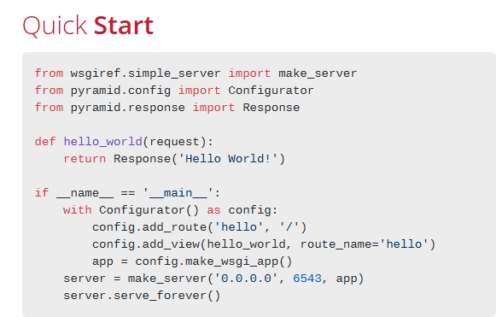
Framework for data engineering Django
This framework is highly flexible and scalable, allowing developers to start small and add functionality as the project grows.
Best for: Large, complex projects that need to grow over time and require a flexible architecture.

Slide 6
Web Framework for Data Engineering- Flask
Flask is a lightweight Python micro framework used for building web applications. It's designed to be flexible and easily extendable, making it a good choice for both beginners and experienced developers. Flask helps developers create web applications by providing tools for handling requests, routing URLs, and rendering templates, among other features.

Slide 7
Framework for Data Engineering – Streamlet
Streamlit is best used for: Data dashboards: Streamlit allows users to build interactive dashboards to monitor key performance indicators (KPIs).
Machine learning models: Users can share trained machine learning models with investors and stakeholders via interactive apps.

Slide 8
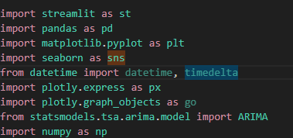
Project Overview
Seaborn: Graphs
Objective: Visualize global COVID-19 trends.
AutoRegressive Integrated Moving Average (ARIMA) model is used for time series analysis and forecasting. Specifically, it is a statistical method for predicting future values of a time series based on its past values,
Tools Used:
Python, Streamlit, Pandas, Plotly, Seaborn, ARIMA
Focus:
Data-driven decisions
Interactive & animated visualizations
Forecasting future COVID-19 cases

Slide 9
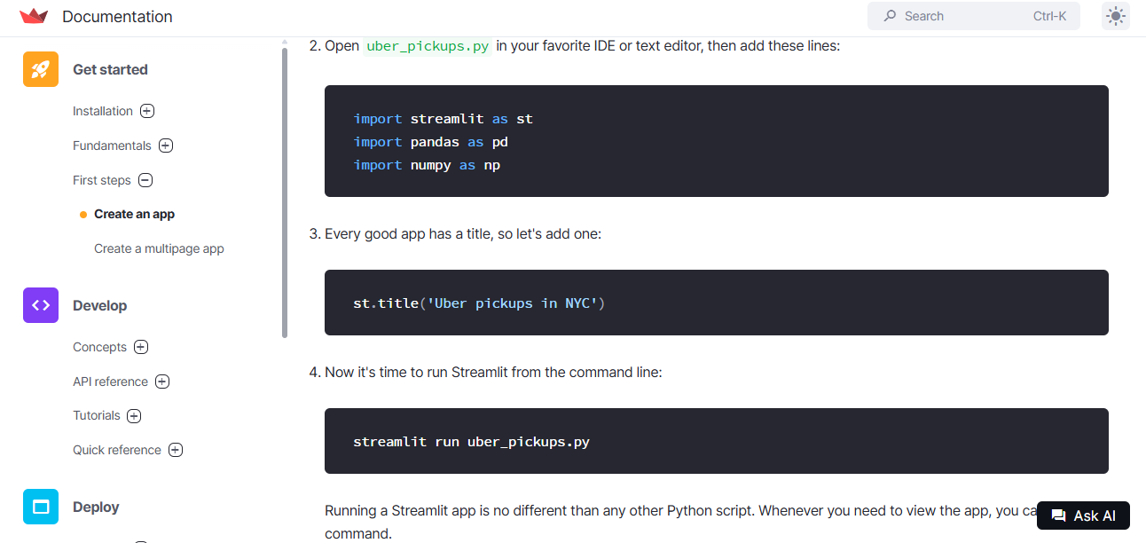
Streamlet Web Server configuration

Slide 10

Streamlet Overview

Slide 11
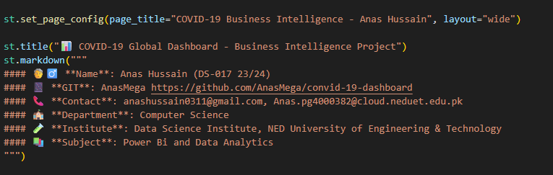
Streamlet Overview

Slide 12
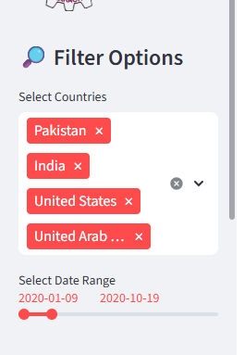
Streamlet Overview

Slide 13
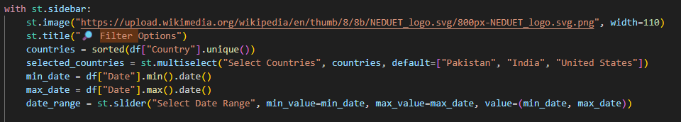
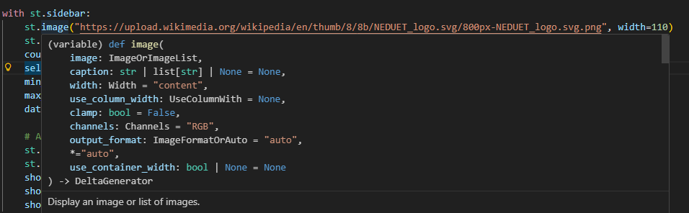
Streamlet Overview (Sidebar)

Slide 14
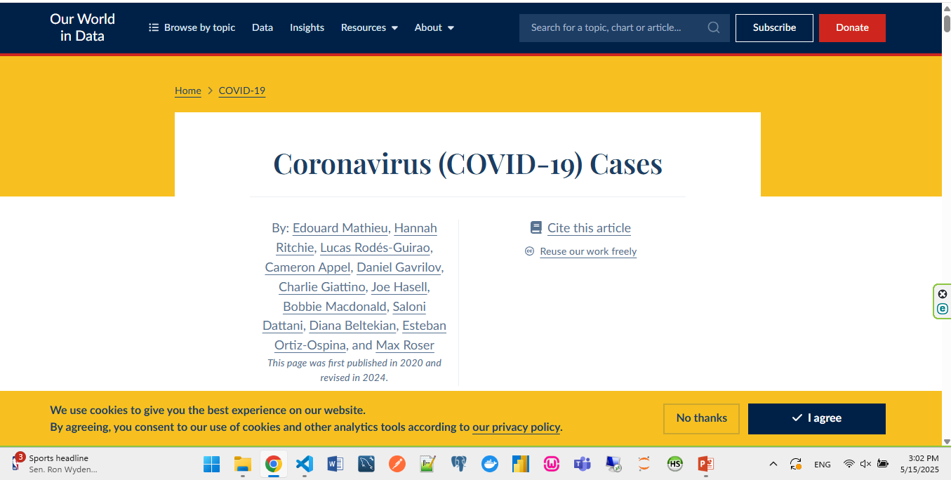
Dataset –Our World in Data

Slide 15
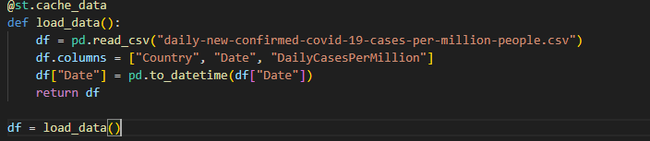
Data loading (pandas)

Slide 16
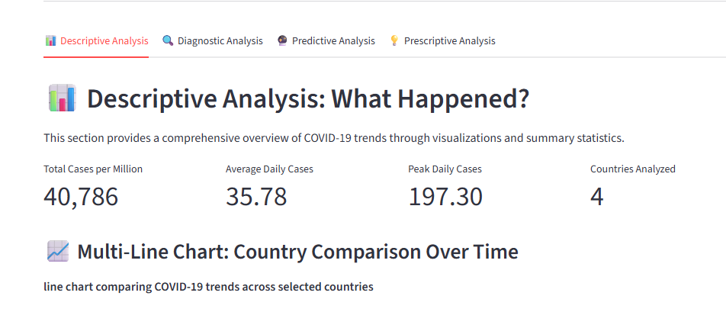
Business Analysis (Descriptve)

Slide 17
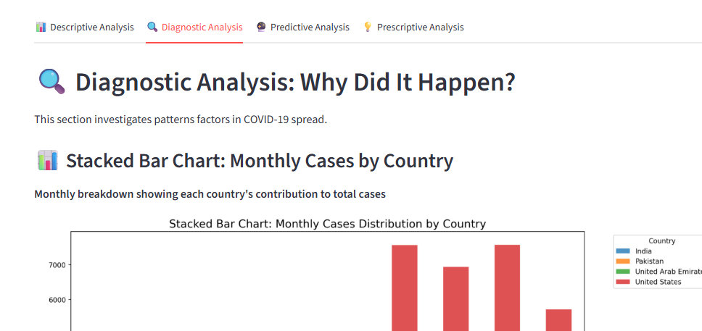
Business Analysis (Diagnostic)

Slide 18
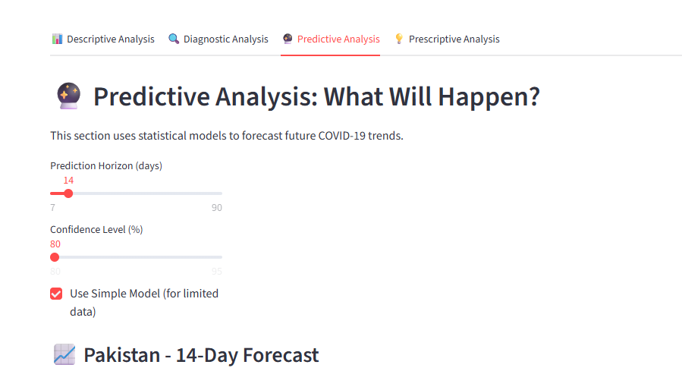
Business Analysis (Predictive)

Slide 19
Business Analysis (Predictive)

Slide 20
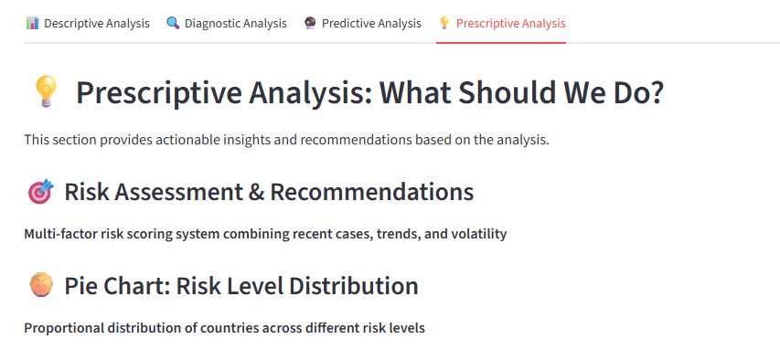
Business Analysis (Prescriptive)

Slide 21
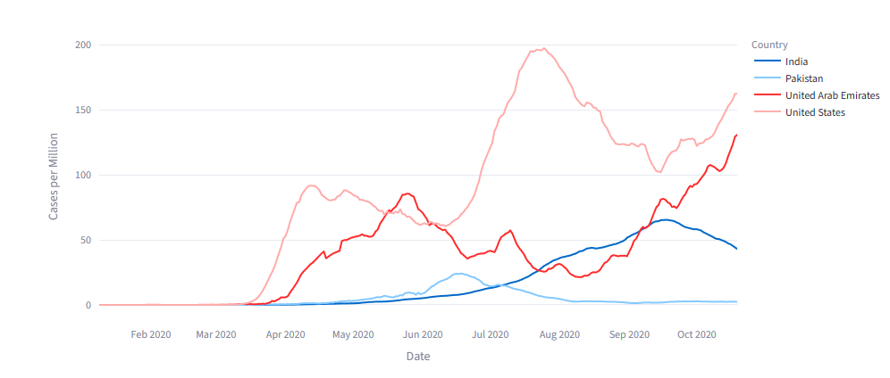
Business Analysis (Descriptive)

Slide 22
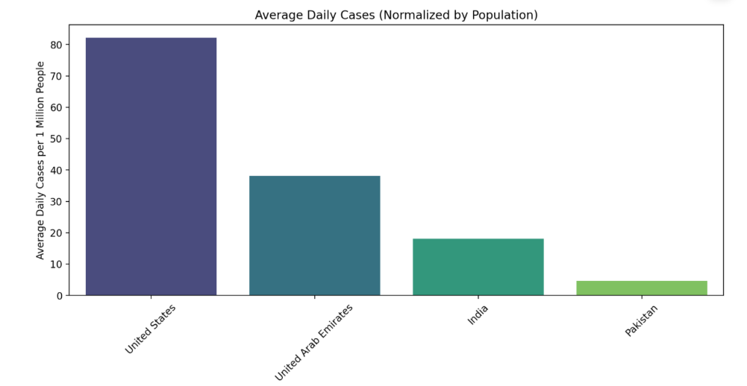
Business Analysis (Descriptive)

Slide 23
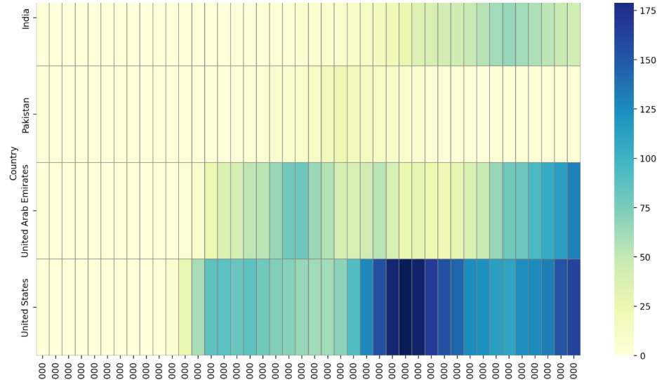
Business Analysis (Diagnostic)

Slide 24
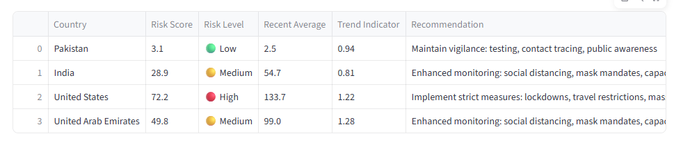

Business Analysis (Prescriptive)

Slide 25
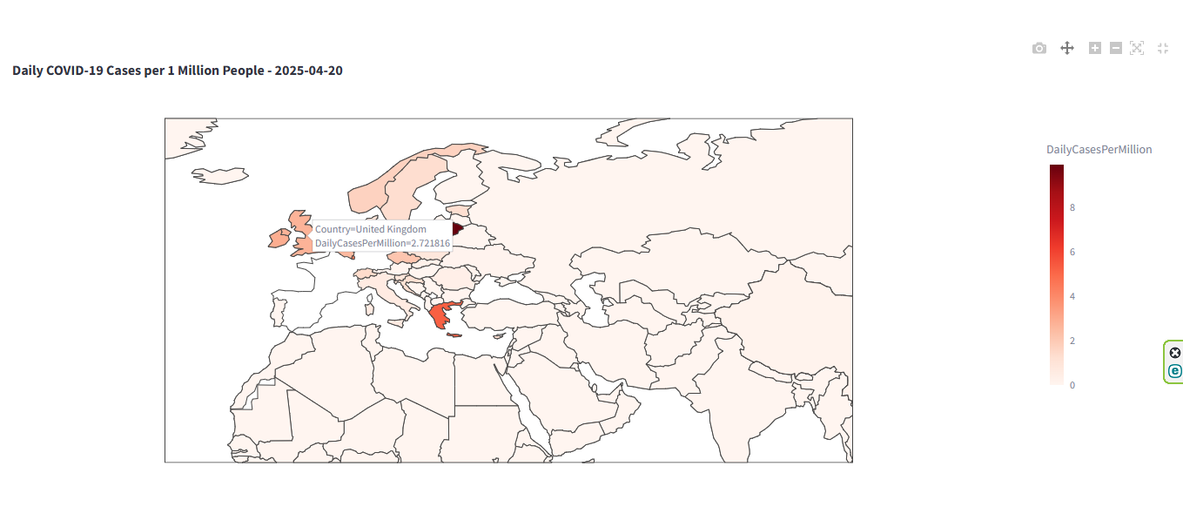
Map View – Streamlit -Choropleth Map

Slide 26
System Architecture / Diagram
Language: Python 3.x
Libraries: Streamlit, Pandas, Seaborn, Matplotlib, Plotly, ARIMA
Prediction Model: ARIMA (Auto Regressive Integrated Moving Average)
Deployment: Localhost /github: AnasMega/ Web App with sidebar filters
Data Source:
COVID: Our World in Data

Slide 27
Flowchart
START
↓
Load & Cache Data
↓
User Filters (Country, Date)
↓
Data Aggregation & Transformation
↓
Generate Visualizations
↓
ARIMA Model Forecast
↓
Display Dashboard data
↓
END

Slide 28
Why Use Streamlit?
Fast to develop: Write Python scripts, and your app is ready.
Beautiful UI with minimal code.
Great for:
Data science dashboards
Machine learning demos
Visualization tools
Internal tools
import streamlit as st
st.title("BMI Calculator")
weight = st.number_input("Enter your weight (kg):")
height = st.number_input("Enter your height (m):")
if weight > 0 and height > 0:
bmi = weight / (height ** 2)
st.success(f"Your BMI is: {bmi:.2f}")
Streamlit Community Cloud (free)
Private cloud / Docker
Heroku / AWS / Azure

Slide 29
Why Use Streamlit?
AR (AutoRegressive): Model that uses past values to predict the current value.
I (Integrated): Makes the time series stationary (removes trend) using differencing.
MA (Moving Average): Uses past forecast errors to predict future values. ARIMA is used for forecasting time series data (like stock prices, sales, weather, etc.).

Slide 30
Results / Insights
COVID cases showed peak differences by country with the
type of business analysis.
Countries like India, US showed higher per capita spikes.
ARIMA predictions gave stable near-future forecasting.

Slide 31
Key Performance Indicators (KPIs) for COVID-19 Dashboard
Case Metrics KPIs
Daily New Cases per Million: The core metric showing normalized infection rates
7-Day Rolling Average: Smoothed trend of case progression
Peak Case Rate: Highest daily cases per million recorded
Case Acceleration: Rate of change in daily cases (derivative of case curve)
Predictive KPIs
Forecast Accuracy: How well predictions match actual future values
Projected Peak Timing: Predicted date of next case surge
Public Health KPIs
Doubling Time: Days for cases to double at current rate
Percent Change: Week-over-week case changes
Vaccination Correlation: (Would require additional data)
User Engagement KPIs (for dashboard itself)
Countries Selected: Breadth of comparative analysis
Date Range Selected: Depth of historical analysis
Visualization Interactions: Usage of interactive elements
Data Downloads: Utilization of export functionality

Slide 32
Limitations
COVID data is historical; no longer real-time.
ARIMA model is simple—limited accuracy for chaotic data.
Streamlit has some performance constraints for larger data
Notes:
In Slide Show mode, select the arrows to visit links.

Slide 33
Conclusion
Created a complete interactive dashboard for COVID-19 insights for descriptive
And diagnostic analyysis.
Demonstrated forecasting using ARIMA for predictive analysis.
Project demonstrates strong command over visualization & data science.
Notes:
In Slide Show mode, select the arrows to visit links.

Slide 34
Any Questions?
Thank You!
Notes:
In Slide Show mode, select the arrows to visit links.

